Slide 1
Introduction to Software Engineering
Amit Singh

Slide 2
Overview
What is Software?
Software Engineering?
Software Products
Why Software is Important?
Software costs
Features of Software?
Software Applications
Why worry about SW Engineering?

Slide 3
What is Software?
The product that software professionals build and then support over the long term.
Software encompasses:
  instructions (computer programs) that when executed provide desired features, function, and performance;
  data structures that enable the programs to adequately store and manipulate information and
  documentation that describes the operation and use of the programs

Slide 4
Documentation : Types
Requirements - Statements that identify attributes, capabilities, characteristics, or qualities of a system. This is the foundation for what shall be or has been implemented.
Architecture/Design - Overview of software. Includes relations to an environment and construction principles to be used in design of software components.
Technical - Documentation of code, algorithms, interfaces, and APIs.
End user - Manuals for the end-user, system administrators and support staff.
Marketing - How to market the product and analysis of the market demand.

Slide 5
Software Products
Generic products
  Stand-alone systems that are marketed and sold to any customer who wishes to buy them.
  Examples – PC software such as editing, graphics programs, project management tools; CAD software; software for specific markets such as appointments systems for dentists.
Customized products
  Software that is commissioned by a specific customer to meet their own needs.
  Examples – embedded control systems, air traffic control software, traffic monitoring systems.

Slide 6
Software Engineering?
[Software engineering is] the establishment and use of sound engineering principles in order to obtain economical software that is reliable and works efficiently on real machines.
The IEEE definition:
  Software Engineering: (1) The application of a systematic, disciplined, quantifiable approach to the development, operation, and maintenance of software; that is, the application of engineering to software. (2) The study of approaches as in (1).

Slide 7
Software Engineering?
According to Wikipedia:
  The systematic application of scientific and technological knowledge, methods, and experience to the design, implementation, testing, and documentation of software
  The establishment and use of sound engineering principles in order to economically obtain software that is reliable and works efficiently on real machines

Slide 8
Why Software is Important?
The economies of ALL developed nations are dependent on software.
More and more systems are software controlled (transportation, medical, telecommunications, military, industrial, entertainment ...)
Software engineering is concerned with theories, methods and tools for professional software development.

Slide 9
Software costs
Software costs often dominate computer system costs. The costs of software on a PC are often greater than the hardware cost.
Software costs more to maintain than it does to develop. For systems with a long life, maintenance costs may be several times development costs.
Software engineering is concerned with cost-effective software development.

Slide 10
Features of Software?
Characteristics that make software different from other human built things.
  Software is Developed or engineered, not manufactured.
  doesn't "wear out.” but it deteriorates (due to change).
Component-based construction
  Modern reusable components encapsulate data and processing into software parts to be reused by different programs. E.g. graphical user interface, window, pull-down menus in library etc.
Yet, most software continue to be custom-built.

Slide 11
Software Applications Examples
System software:
  such as compilers, editors, file management utilities
Application software
  stand-alone programs for specific needs.
Engineering/scientific software
  Characterized by “number crunching”algorithms. such as automotive stress analysis, molecular biology, orbital dynamics etc
Embedded software
  resides within a product or system. (key pad control of a microwave oven, digital function of dashboard display in a car)
Product-line software
  focus on a limited marketplace to address mass consumer market. (word processing, graphics, database management)

Slide 12
Software Applications Examples
WebApps
  (Web applications) network centric software. As web 2.0 emerges, more sophisticated computing environments is supported integrated with remote database and business applications.
AI
  software uses non-numerical algorithm to solve complex problem. Robotics, expert system, pattern recognition game playing

Slide 13
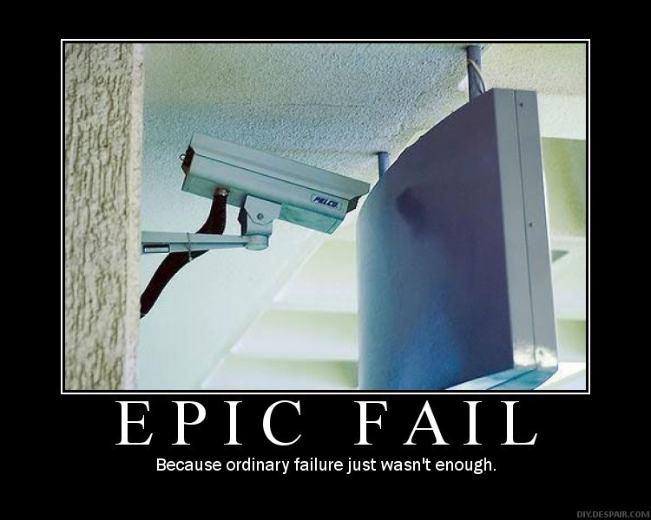
Why worry about SW Engineering?
Quality issues: History of SW failures from http://www.wired.com/software/coolapps/news/2005/11/69355
  Many more incidents…

Slide 14
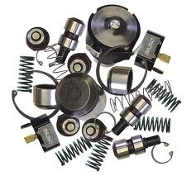
Why is it so hard?
Lots of “parts”. Many more than mechanical devices
  Dishwasher - 128 parts
  Car - 14,000 parts
  Space shuttle - 2.5 million parts
  Red Hat Linux 7.1 - 30 million source lines of code (SLOC)
  Mac Office - 30 million SLOC
  Using 70 programmers = 428,000 SLOC / programmer
  But those are big… what about “normal size programs”?
    Average programmer SLOC (Source lines of code) / day = 100
    5 days/week * 52 weeks/year = 26,000 SLOC / year
    15 programmer team = 390,000 SLOC / year

Slide 15
Why do projects fail?
Why do projects fail so often?
  Unrealistic or unarticulated project goals
  Inaccurate estimates of needed resources
  Badly defined system requirements
  Poor reporting of the project's status
  Unmanaged risks
  Poor communication among customers, developers, and users
  Use of immature technology
  Inability to handle the project's complexity
  Sloppy development practices
  Poor project management
  Stakeholder politics
  Commercial pressures

Slide 16
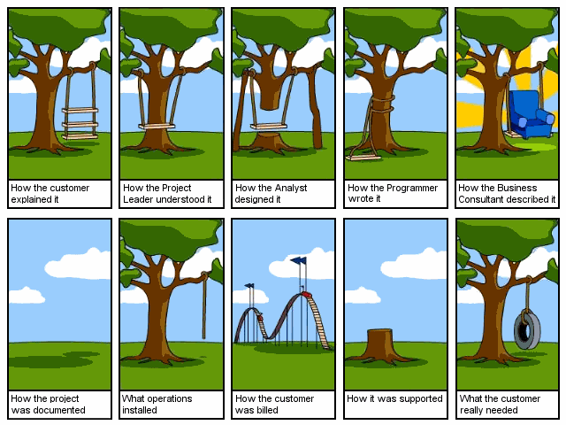
Why do projects fail?

Slide 17
How do we fix it?
Need to have more reproducible results
  Standard processes / procedures to produce good outcomes
  Design patterns
  Object oriented programming (reuse)
More measurements of both the software and the process
More testing at all stages of development
By creating a better understanding of the process we use to create software, we’ll create better software faster.
“Software engineering is the application of a systematic, disciplined, quantifiable approach to the development, operation, and maintenance of software.” - IEEE Standard Glossary of Software Engineering Terminology

Slide 18
Is it essential ?
Software engineering!
Software engineering is really just a set of ideas and tools to use (when it makes sense) to
give you a higher likelihood of success on a software project.
Will your project fail if you don’t use any software engineering techniques?
  No…. but you have a better chance at success if you do.

Slide 19
A Generic Framework
Communication
  Heavy collaboration with the customer, other stakeholders and encompasses requirements gathering and related activities
Planning
  Establish a plan for the work. Technical task to be conducted, risks, needed resources, work products to be created, and a schedule
Modeling
  Creation of models to allow the customer and the developer to better understand the requirements and design that will achieve those requirements
Construction
  Combines code generation and testing required to uncover errors in the code
Deployment
  The software (as a complete entity or partially complete increment) is delivered to the customer who evaluates it and provides feedback.

Slide 20
Framework Activities
Communication
Planning
Modeling
  Analysis of requirements
  Design
Construction
  Code generation
  Testing
Deployment

Slide 21
Umbrella Activities
Software project management
Formal technical reviews
Software quality assurance
Software configuration management
Work product preparation and production
Reusability management
Measurement
Risk management

Slide 22
END

